Slide 1
Part III 3Working with Software-Based AI Applications
Perform data analysis.
Consider the relationship between AI and machine learning.
Consider the relationship between AI and deep learning

Slide 2
Chapter 9 Performing Data Analysis for AI
Understanding how data analysis works
Using data analysis effectively with machine learning
Determining what machine learning can achieve
Discovering the different kinds of machine learning algorithms

Slide 3
Amassing data isn’t a modern phenomenon; people have amassed data for centuries.
Data has a value in itself.
People have recently learned that data contains more than surface information.
If data is in an appropriate numerical form, you can apply special techniques devised by mathematicians and statisticians, called data analysis techniques, and extract even more knowledge from it.

Slide 4
Simple data analysis, you can extract meaningful information.
More advanced analytics using machine learning algorithms capable of predicting the future, classifying information, and effectively helping to make optimal decisions.
Data analysis and machine learning enable people to push data usage beyond previous limits to develop a smarter AI.

Slide 5
Defining Data Analysis
The current era is called the Information Age not simply because we have become so data rich but also because society has reached a certain maturity in analyzing and extracting information from that data.
“Data is the new oil” implies both that data can make a company rich and that it takes skill and hard work to make this happen.
The most basic data transformations are provided by data analysis.

Slide 6
Data analysis, depending on the context, refers to a large body of possible data operations, sometimes specific to certain industries or tasks.
Transforming: Changes the data’s structure.
Cleansing: Fixes imperfect data.
Inspecting: Validates the data.
Modeling: Grasps the relationship between the elements present in data.

Slide 7
You perform transformations, cleansing, inspecting, and modeling.
The data analysis arsenal also provides basic statistical tools, such as mean and variance, that describe data distribution, or sophisticated tools, such as correlation and linear regression analysis, that reveal whether you can relate events or phenomena to one another.
What makes data analysis hard in the age of big data is the large volume of data that requires special computing tools, such as Hadoop and Apache Spark, which are two software tools used to perform massive data operations.

Slide 8
Understanding why analysis is important
Data analysis is essential to AI. In fact, no modern AI is possible without visualizing, cleansing, transforming, and modeling data before advanced algorithms enter the process and turn it into information of even higher value than before.
In the beginning, when AI consisted of purely algorithmic solutions and expert systems, scientists and experts carefully prepared the data to feed them.

Slide 9
Manipulating known data into a specific form posed a serious limitation because crafting data required a lot of time and energy.
Today, the attention has shifted from data production to data preparation by using data analysis.

Slide 10
Reconsidering the value of data
With the explosion of data availability on digital, data assumes new nuances of value and usefulness beyond its initial scope of instructing (teaching) and transmitting knowledge (transferring data).
The abundance of data, when provided to data analysis, acquires new functions:
Data describes the world better by presenting a wide variety of facts, and in more detail by providing nuances for each fact.
Data shows how facts associate with events.

Slide 11
In some respects, data provides us with new super-powers.
Large amounts of data can help scientific discoveries outside the scientific method.
Applying algorithms to learn directly from data.

Slide 12
In the past, scientists took uncountable observations and a multitude of experiments to gather enough deductions to describe the physics of the universe using the scientific method. This manual process allowed scientists to find many underlying laws of the world.
The ability to innovate using data alone is a major breakthrough in the scientific quest to understand the world.

Slide 13
Defining Machine Learning
The pinnacle of data analysis is machine learning.
You can successfully apply machine learning only after data analysis provides correctly prepared input.
However, only machine learning can associate a series of outputs and inputs, as well as determine the working rules behind the output in an effective way.
Machine learning strictly focuses on taking inputs from data and elaborating a working, internal representation of the world that you can use for practical purposes.

Slide 14
The central idea behind machine learning is that you can represent reality by using a mathematical function that the algorithm doesn’t know in advance, but which it can guess after seeing some data. You can express reality and all its challenging complexity in terms of unknown mathematical functions that machine learning algorithms find and make actionable. This concept is the core idea for all kinds of machine learning algorithms.

Slide 15
Learning in machine learning is purely mathematical, and it ends by associating certain inputs to certain outputs.
The learning process is often described as training because the algorithm is trained to match the correct answer (the output) to every question offered (the input).
In spite of lacking deliberate understanding and being simply a mathematical process, machine learning can prove useful in many tasks.

Slide 16
Understanding how machine learning works
In the past, writing a program meant understanding the function used to manipulate data to create a given result with certain inputs.
Machine learning turns this process around.
Training provides a learner algorithm with all sorts of examples of the desired inputs and results expected from those inputs. The learner then uses this input to create a function.

Slide 17
ML builds its cognitive capabilities by creating a mathematical formulation that includes all the given features in a way that creates a function that can distinguish one class from another.
Being able to express such mathematical formulation is the representation capability of the machine learning algorithm.
From a mathematical perspective, you can express the representation process in machine learning by using the equivalent term mapping
Mapping happens when you discover the construction of a function by observing its outputs.

Slide 18
Such a representation (abstract rules derived from real-world facts) is possible because the learning algorithm has many internal parameters (consisting of vectors and matrices of values), which equate to the algorithm’s memory for ideas that are suitable for its mapping activity that connects features to response classes.
The dimensions and type of internal parameters delimit the kind of target functions that an algorithm can learn.
An optimization engine in the algorithm changes parameters from their initial values during learning to represent the target’s hidden function.

Slide 19
During optimization, the algorithm searches the possible variants of its parameter combinations to find one that allows correct mapping between features and classes during training.
This process evaluates many potential candidate target functions from among those that the learning algorithm can guess.
The set of all the potential functions that the learning algorithm can discover is the hypothesis space.

Slide 20
Understanding the benefits of machine learning
You can find AI used in many other ways. However, it’s also useful to view uses of machine learning outside the normal realm that many consider the domain of AI.
Access control
Animal protection
Predicting wait times

Slide 21
Specifying the limits of machine learning
Machine learning relies on algorithms to analyze huge datasets.
Currently, machine learning can’t provide the sort of AI that the movies present.
Even the best algorithms can’t think, feel, display any form of self-awareness, or exercise free will.
The main point of confusion between learning and intelligence is people’s assumption that simply because a machine gets better at its job (learning), it’s also aware (intelligence).

Slide 22
Apart from the fact that machine learning consists of mathematical functions optimized for a certain purpose, other weaknesses expose the limits of machine learning.
Representation
Overfitting
Lack of effective generalization because of limited data

Slide 23
The secret to machine learning is generalization.
The goal is to generalize the output function so that it works on data beyond the training examples.
However, with generalization come the problems of overfitting and biased data (data that when viewed using various statistical measures is skewed in one direction or the other).
The algorithm may respond correctly to situations similar to those used to train it, but it will be clueless in completely new situations.

Slide 24
Considering How to Learn from Data
Everything in machine learning revolves around algorithms.
An algorithm is a procedure or formula used to solve a problem.
Learning comes in many different flavors, depending on the algorithm and its objectives.
Supervised learning
Unsupervised learning
Reinforcement learning

Slide 25
Supervised learning
Supervised learning occurs when an algorithm learns from example data and associated target responses that can consist of numeric values or string labels, such as classes or tags, in order to later predict the correct response when given new examples.

Slide 26
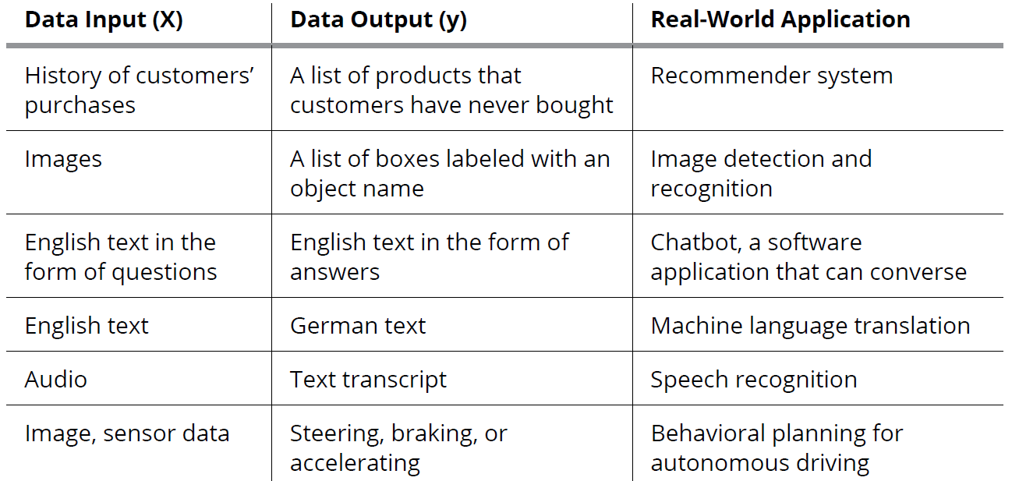

Slide 27
Unsupervised learning
Unsupervised learning occurs when an algorithm learns from plain examples without any associated response, leaving the algorithm to determine the data patterns on its own.

Slide 28
Reinforcement learning
Reinforcement learning occurs when you present the algorithm with examples that lack labels, as in unsupervised learning. However, you can accompany an example with positive or negative feedback according to the consequences of the solution that the algorithm proposes.

